Slide 1
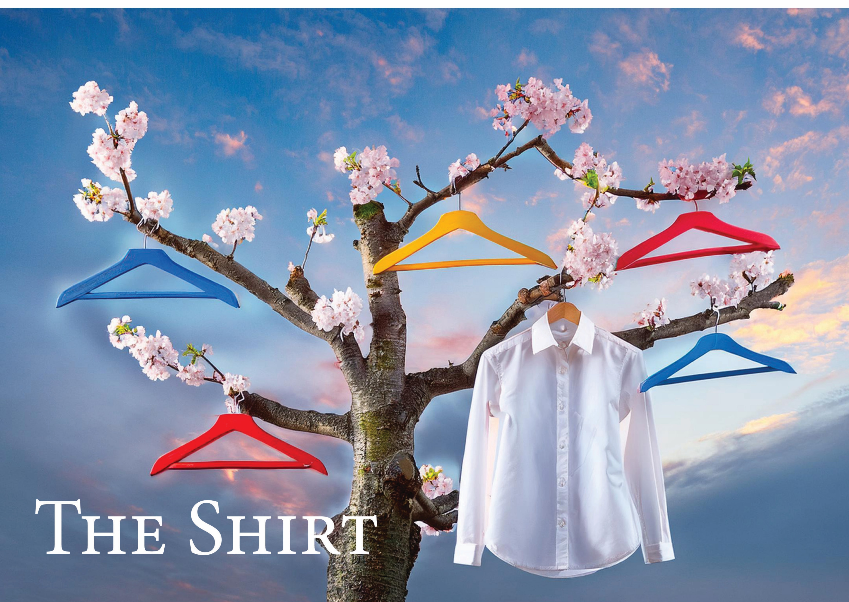
Navin Patel Specialist Garment Technician MA Fashion Design Technology

Slide 2
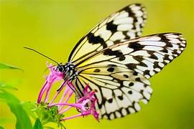
My research question was going to be,
How can Technicians Decolonise their Workshops?
But as I do not personally like the word decolonisation,
I have called my research question
How can Technicians Cross-Pollinate their Workshops?
Being bought up within a dual background of a traditional
Hindu family within British culture,
it is important for me for to take the best of each background
to cross-pollinate and not destroy, ignore, or condemn in
Representing the person who I am today.
Cross- Pollination :
How we can take
two different DNA‘s
and create something new
By taking the best of each background to cross-pollinate and
not destroy, ignore, or condemn in representing the person who I am today
Notes:
My research question was going to be, ‘How Technicians can Decolonise their Workshops.’ But as I do not personally like the word decolonisation, I have called my research question ‘How Technicians can Cross-Pollinate their Workshops’.
Being brought up within a dual background of a traditional Hindu family within British culture, it is important for me for to take the best of each background to cross-pollinate and not destroy, ignore, or condemn in representing the person who I am today.
Cross- Pollination - How we can take two different DNA‘s and create something new

Slide 3

THE SHIRT
Brief Background
The Writing Task 20 minutes
The Collage Task 20 minutes
The Draping Task 20 minutes
Questionnaire
Light Lunch 2pm vacate the room

Slide 4
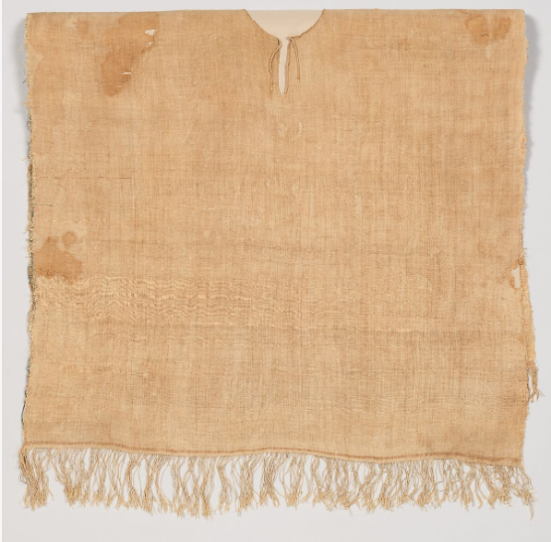
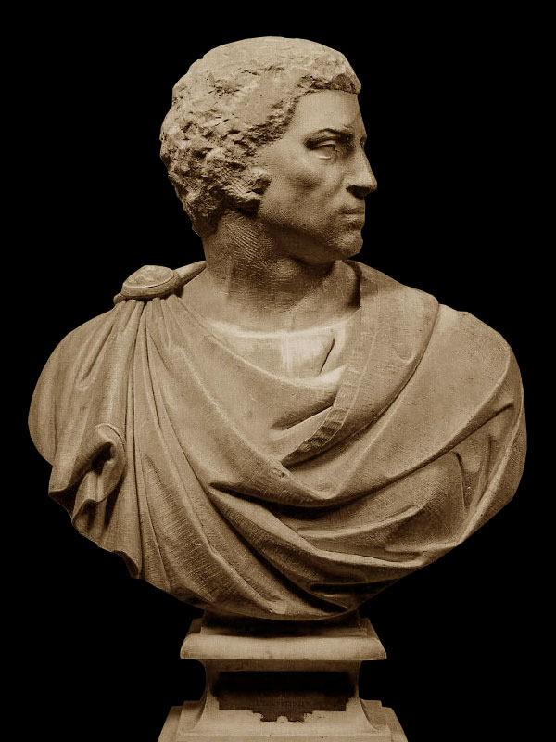
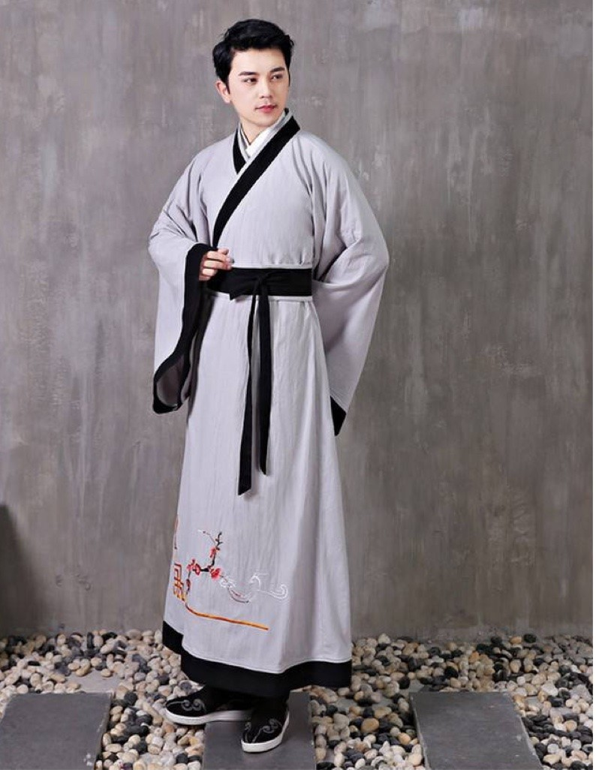
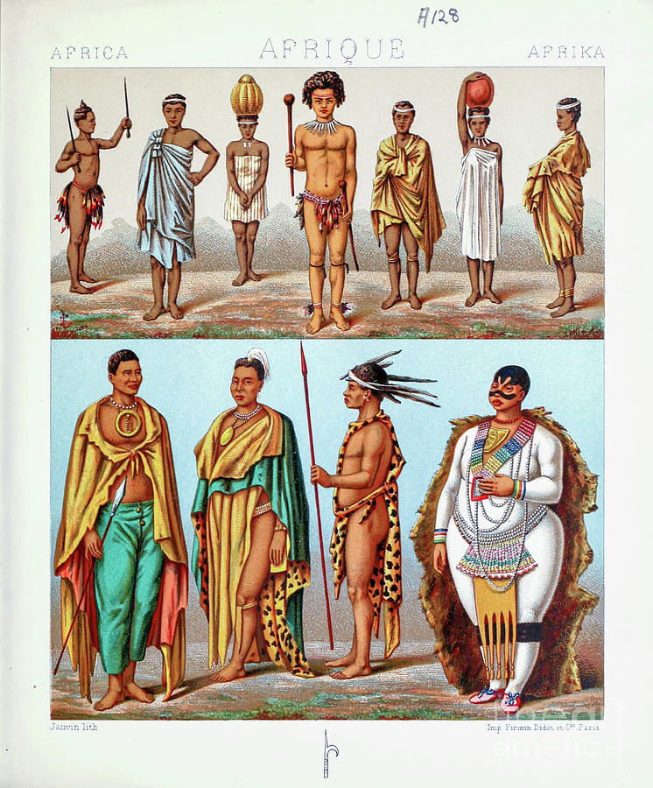
Ancient Egyptians used the finest woven linen as an expression of class
c 3500 bce
v&a
The smock signalled a change in men’s fashion Brutus
c 85 bce
museum of bargello Florence
The Shenyi
Also spread to Korea & Japan
c 960-1360 ce
https://chine365.fr/culture/hanfu-shenyi
A continent of 54 countries and
pre-colonial tribal traditions
https://ar.inspiredpencil.com
EGYPT
ITALY
CHINA
AFRICA

Slide 5
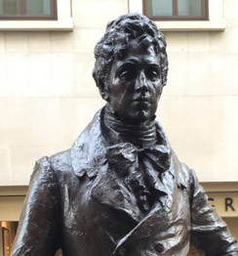
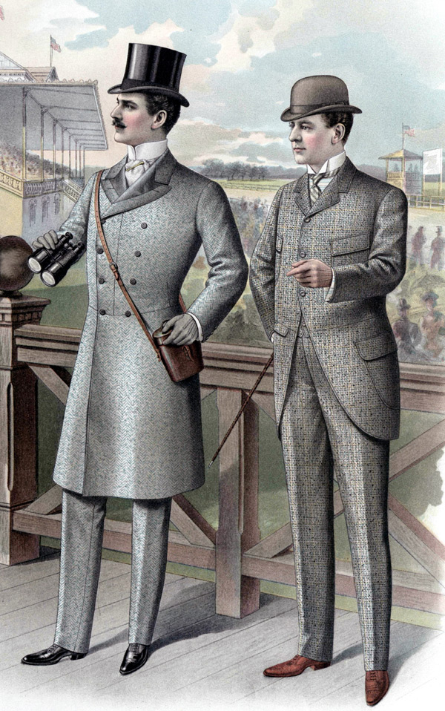

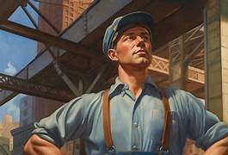
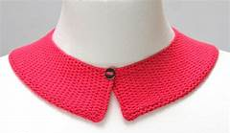
Wealth, status and cleanliness
Working men America
High neckcloths were abandoned for collars and ties more or less the same as those worn in the 20th and 21st centuries
Females paid less than males
Brummell set the mode in 1806 for the ruffled shirt for both day and evening wear. Men’s clothing became more sombre in the Victorian age..
Edwardian England
White Blue Pink
c1806
c1906
C20th

Slide 6
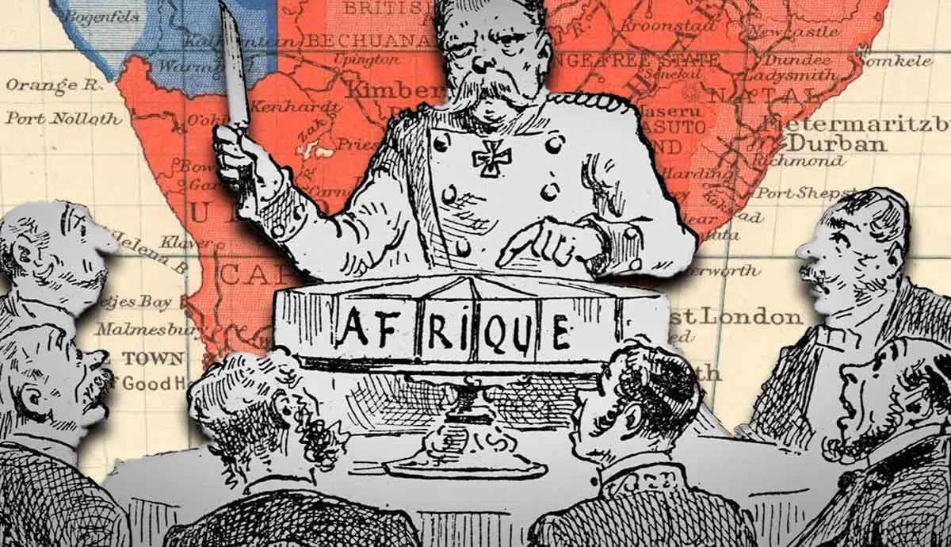
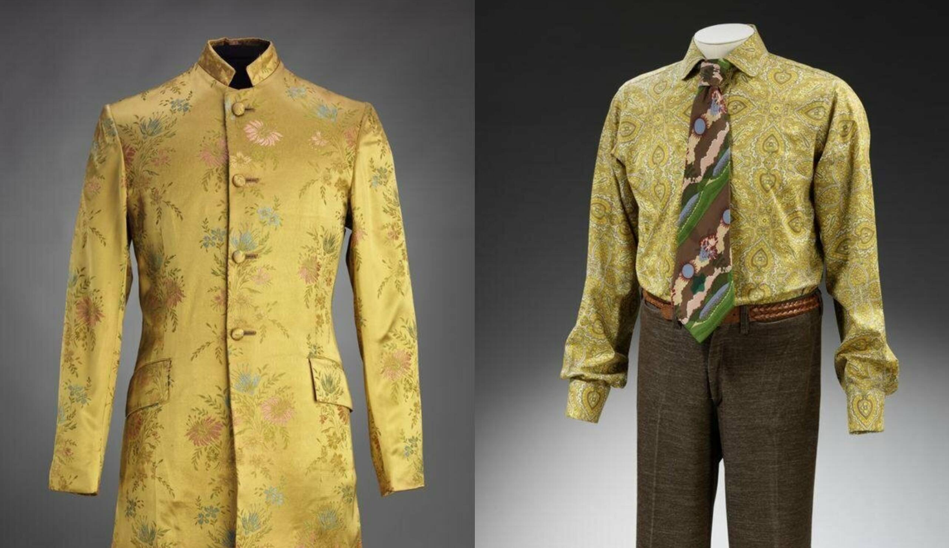
Colonisers
used their Christianity and misogynistic forms of dress to enforce their values despite geological, practical, spiritual and belief systems.
For example, African women were no longer allowed to be topless and thus were conditioned to the fact that they must conform to European notions of modesty, apparent self-respect, and innocence, or be punished.
However, in India, some styles have been adopted in western fashion – Notably the Nehru jacket.
Notes:
From Kente to Colonialism: African Fashion Over Time
https://adht.parsons.edu/fashionstudies/bias-post/from-kente-to-colonialism-african-fashion-over-time/
One key piece of African style composition pre-colonialism was the geographical element of the equator. The closer a community got to this hemisphere border, the less clothing they wore because of the immensely hot and dry summer season. Unfortunately, this very liberation of the body was immediately struck down by colonizers who used their Christianity and misogynistic forms of dress to enforce modesty upon colonized areas where this word and ideology had no meaning
The ‘Scramble for Africa’
https://www.bbc.co.uk/bitesize/topics/z7kvf82/articles/zrfjqfr#zqssf82
By the 1870s, many European countries were looking to expand their control in Africa.
At the Berlin Conference in 1884, the USA, the Ottoman Empire and 12 European countries divided up most of the African continent between them. This is known as the ‘Scramble for Africa’.
We can still see the impact of the ‘Scramble for Africa’ today, in the languages spoken in former African colonies, how their governments work and how their education systems are run. These changes often came at the expense of African languages, cultures and systems that existed before colonisation
V&A – Nehru jacket image In the pink

Slide 7
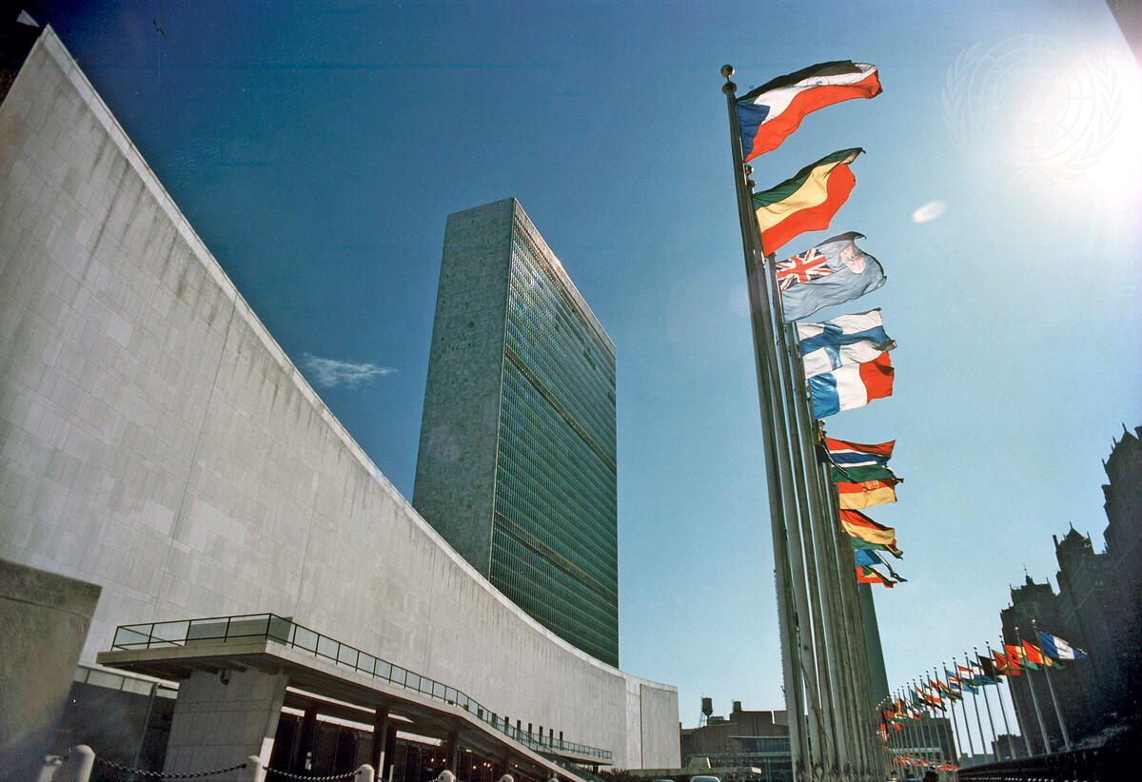
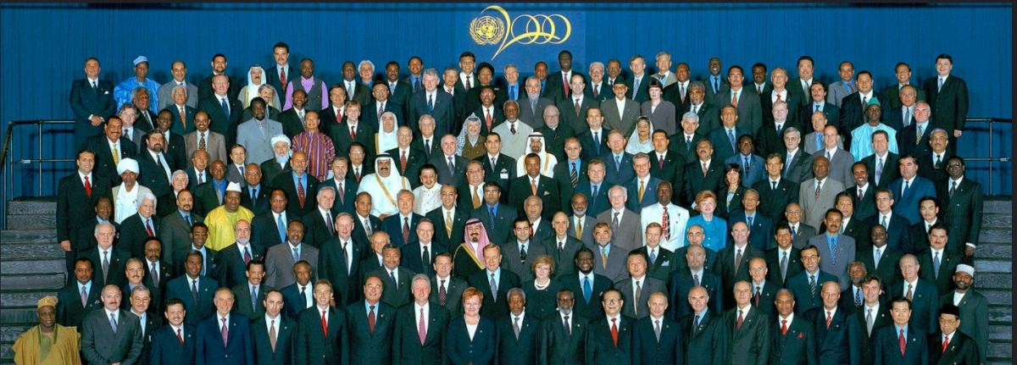
The cultural context of colour
varies significantly
Yet the white shirt is
universally ubiquitous and
has impacted most societies
Notes:
Changes in this clothing usually lie in the type of collar and sleeves as the inner for suits as men’s formal wear. White shirts were originally worn by elite consumers rather than the middle class. The middle-class people rarely wore white shirts because a special washing treatment was needed for white shirts.
In Indonesia, the use of shirts or clothing similar to shirts was discovered in the 17th century as the inner layer of a jacket (kalambi) that was influenced by Western clothing.
https://www.aristocracy.london/beau-brummell-the-dandy-who-invented-mens-suits/
https://people.howstuffworks.com/white-collar-and-blue-collar.htm
In the 1970s, people noticed that women were pretty much kept out of both blue-collar and white-collar jobs. They were able to work as teachers (but not professors), secretaries, nurses, and other caregiving and support roles. These were called "pink collar" jobs, not because the women wore pink but because pink had been associated with girls since the 1950s.
Interestingly, white collar was the first to appear, in 1910
Blue collar first appeared in 1924 in a newspaper in Iowa
WHITE-COLLAR | English meaning - Cambridge Dictionary

Slide 8
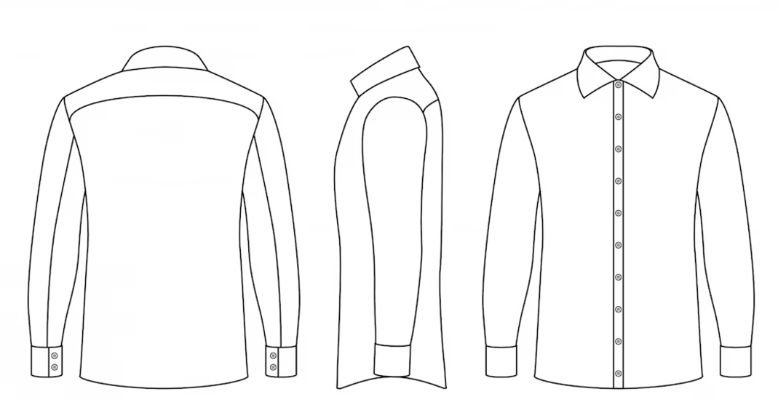
The Writing Task
(20 minutes) groups A & B
1 Create a mind map from the questions – See handout
2 On the front of the shirt only, pick out and write the keywords
from your mind map
3 On the back of the shirt only, pick out and write which keywords regarding the name London College of Fashion, (which started as an all girls school in 1906, then allowing boys to join later, what does it mean to us) and
How using the word London, and what does it makes us think about
4 On the right sleeve of the shirt only and thinking about East Bank Stratford now, how the history of the East End London became a trading area for people and goods, what thoughts come to mind
5 On the left sleeve of the shirt only and through the lens of educators, how can arts university Cross-Pollinate the words on your shirt to improve our education system
Notes:
Looking at the name L C F. what symbolism does the inclusion of the word London have to you
Narrowing down to the east end of London and where lcf is now, how might that impact on your views
Looking at the area LCF is in now in the east end, what are your thoughts based upon the history of the area ie trade, immigration

Slide 9
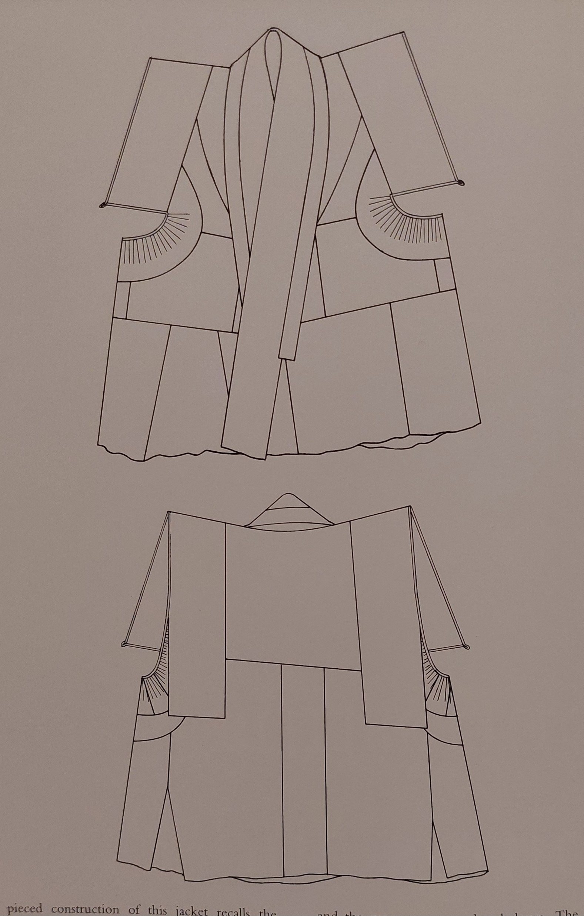
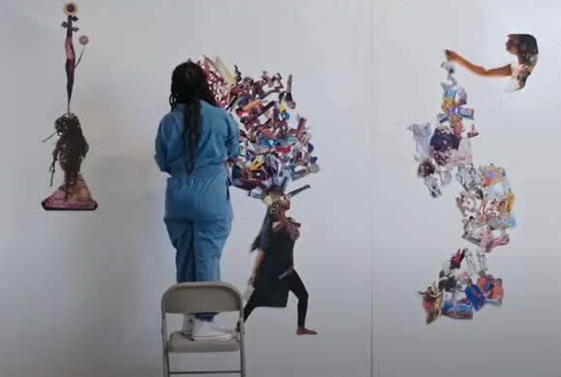
The Collage Task
(20 minutes) groups A & B
1 Pick one member of your team.
Now draw around the top half or their body on paper.
2 On any one third of the body outline, draw part of
a traditional shirt as we know it today.
Within that third, include any detailing you wish.
3 Now it’s time to collage and cross pollinate the remainder of the drawing using our students and each other as a source of inspiration.
Consider heritage, culture, tribe, neurodiversity, music, food, language and social life, to give this collage an identity in the form of a shirt.
Notes:
How to make collage | IN THE STUDIO
The Museum of Modern Art
The Museum of Modern Art
https://www.youtube.com/watch?v=gUOMhVwnQ98

Slide 10
The Draping Task
(20 minutes) groups A & B
You’re now going to take your 2D collage
and turn it into 3D cross-pollinated shirt
1 Look at the white shirt on the mannequin.
Think about your pedagogy in teaching.
Carefully consider the big question of how can we
encourage cross-pollination in our workshops.
Take the keywords and concepts from your 2D collage and discuss how they can be usefully applied to the actual shirt.
2 The aim now is to accomplish your vision by draping onto the mannequin without limits. Cut it if you need to.
What do we need to add? What do we leave out?
Look at the length, body shape and key elements.
3 Then ask – How does this new garment genuinely incorporate and successfully merge various cultures without paying lip service to any particular one?
If it does, then we’ve achieved what we set out to do.
But if it doesn’t then let’s ask why.

Slide 11
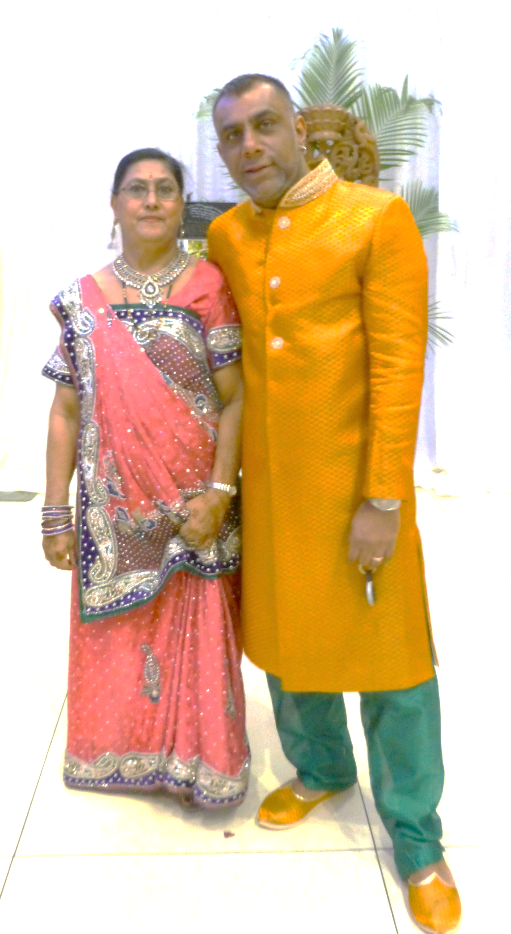
Thank you
My inspiration and me

Slide 12
The Writing Task
Questions you might consider
Do you own a white shirt
What are your memories about wearing a white shirt
Think of the white shirt in relation to: your own positionality, what colonisation means to you. What decolonisation means to you, and how we can cross- pollinate it in workshops
Without an understanding of where you stand in relation to your identities, heritage, culture and tribe, how are you aware of your privileges?
Are you also aware of your identities through oppression and marginalisation, (are they ethical), how do we express this through garments?
What makes you YOU?????
When was it the last time you wore a shirt from your heritage, culture or tribe?
When we talk about decolonisation, we refer to returning to our motherland – How do we remove ‘colonisation’ in terms of how we dress?
So what happens if we try to cross-pollinate and take the best of both worlds?
What part of the shirt do you think comes from the European colonialising countries
How do you think wearing a white shirt effects us socially, culturally, economically, politically and environmentally?

