Slide 1
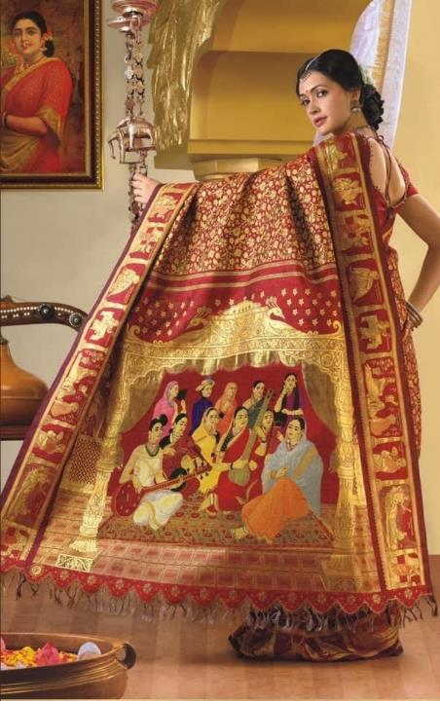
the sari
An ancient garment, adaptable for any culture
Navin Patel
Guinness World of Records 2014
Notes:
After this introduction, you’ll drape on yourselves, then over objects and finally slash before sharing feedback
This was the world’s most expensive sari in 2014, which is now over £130,000

Slide 2
Exquisite detail
On the world’s most expensive sari
In 2014, sari this entered the Guinness World Records worth £140,000 at today’s prices
"The silk sari is made up of navratna stones like diamond, emerald, ruby, yellow sapphire, sapphire, topaz, pearl, cat's eye and coral
It also has embroidered in metals such as gold, platinum and silver" explains Ramesh Raja, Chennai Silks
Navratna stones are believed to hold special powers in the cosmos
Named the 'Vivaah Patu' sari, it features the reproduction of 11 paintings by Indian art icon Raja Ravi Varma and it was designed by the director of Chennai Silks, Sivalingam

Slide 3
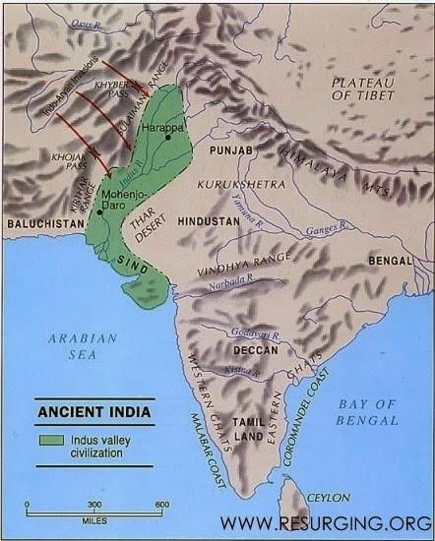
5000 years old
The history of Sari-like drapery can be traced back to the Indus Valley civilisation, which flourished during 2800–1800 bce around the northwestern part of the Indian subcontinent
Cotton was first cultivated and woven on the Indian subcontinent around the 5th millennium bce
Notes:
Cotton was first spun about 5000 by whilst the sari originates from the Indus Valley about 2800 by and was the first zero waste garment

Slide 4
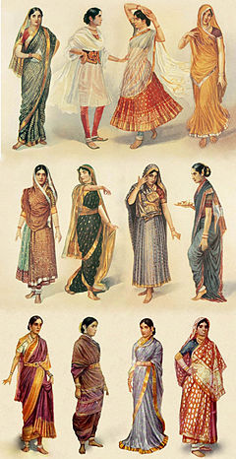
Evolution and history
Sari is the national garment for Indian women and
the men's version is called a Dhoti (loose trousers)
which is mostly paired with the Kurta (jacket / shirt)
The sari was known to be one of the first zero waste garments , many countries and cultures have taken this idea a rapping long length of fabric around them with their own method of draping
The Greeks the Egyptians as well as large parts of Asia and Africa have all created their own unique garments

Slide 5

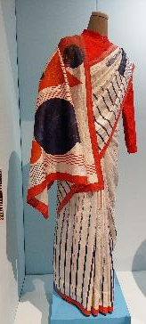

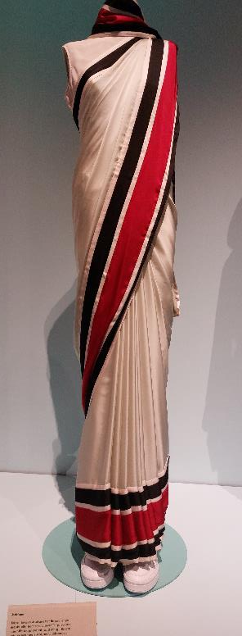
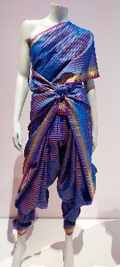
6 metres long
The standard length of a sari is 18 feet long, includes a piece for the sari blouse, which is known as a choli and is woven at the same time

Slide 6
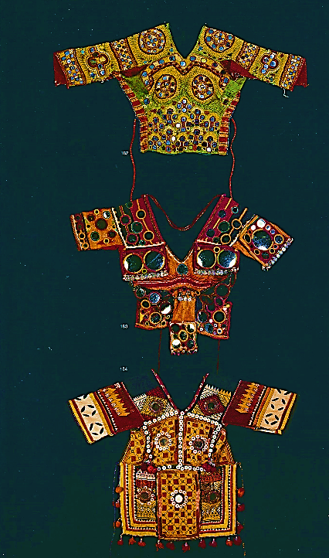



Ghagra Choli Pallu
The sari is worn with an
underskirt petticoat known as Ghagra and
short-fitted blouse known as a Choli
the loose end draped over the shoulder is known as the Pallu
Here you can see mirrors sewn in to the Choli whilst the pattern reflects the region

Slide 7
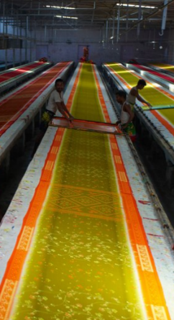
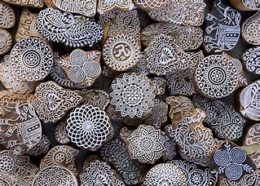
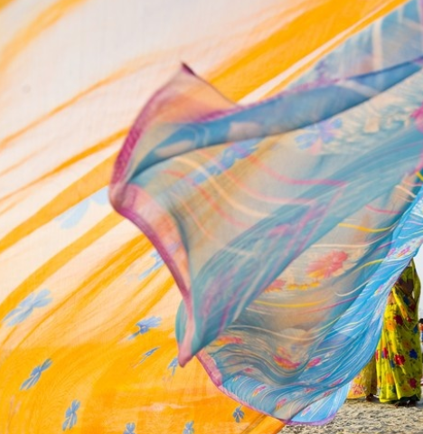
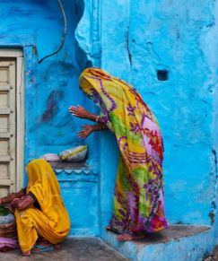
Dreamstime.com
Craftsmanship
There is no need for any two saris to be the same and women take pride in having something unique
The number of ways it can be embellished is endless
Woodblock to create repetition
Dyes local to an area
Hand painted designs
Gold threads
Jewels
Beads
Laser cutting
Fabrics

Slide 8
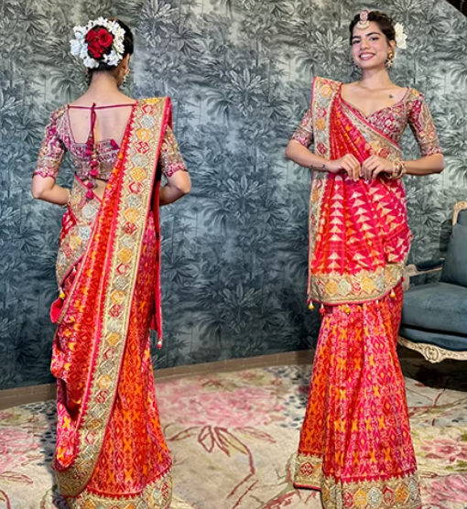
Colour
Is often crucial to the occasion
marriage
Different colours are worn during the festival months
For weddings, the brighter, the shinier, the better
correct negative energy
widow
vigilantes
Notes:
Black - Corrects negative energy
White - Mourning
Pink – Vigilante groups

Slide 9
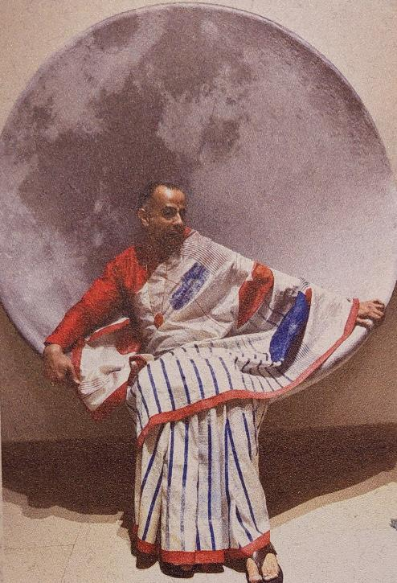
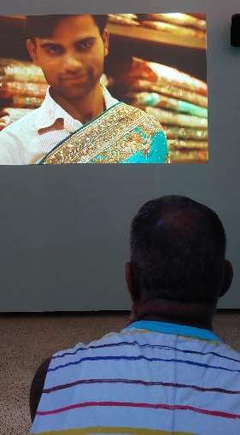
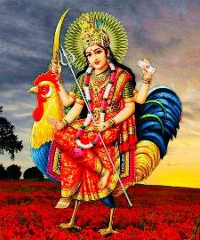
Hijras
Hijras are often born male but look and dress in traditionally feminine ways
Many, but not all, choose to undergo a castration ceremony, removing their male genitalia as an offering to Hindu goddess Bahuchara Mata
Other hijras are born intersex

Slide 10
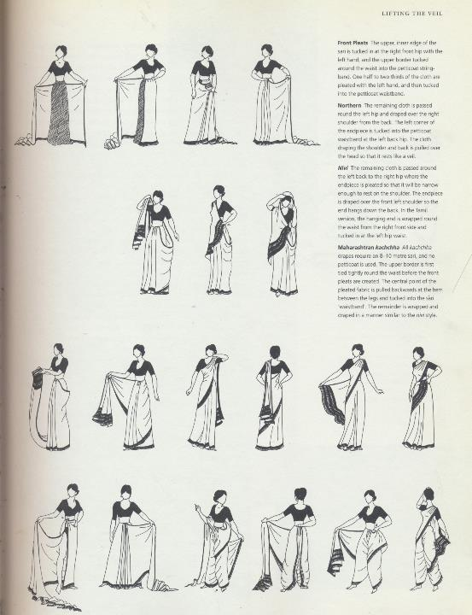
Identity and Practicality
With 650,000 villages in India, it is inevitable that women have evolved different methods of draping the sari to create identity and practicality
Working in the fields, preparing food on the floor, as well as modesty in more personal matters, require a a very practical style of draping a sari
A woman who doesn’t work and has staff will of course have time to drape more complex styles
Identity shows through social status, caste and denomination of faith with colour, fabric and style all playing a part

Slide 11
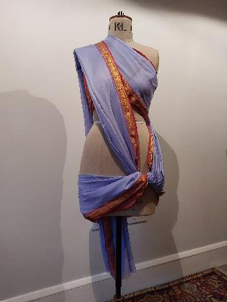
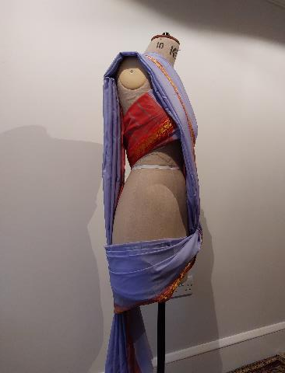
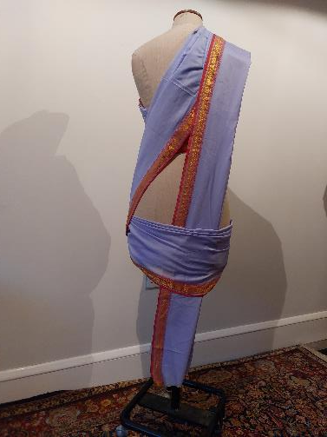
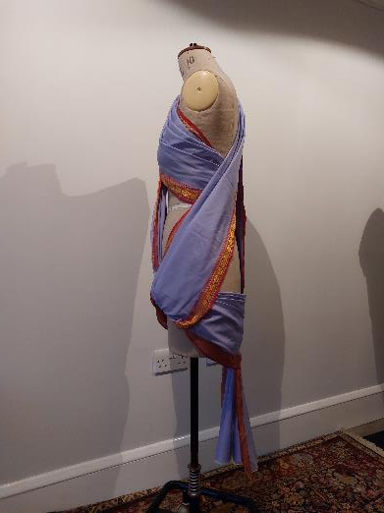
TASK 1
60 minutes
Live draping together
Drape on your partner using certain areas of the sari drapes like
the pallu etc or one of the three illustrations

Slide 12
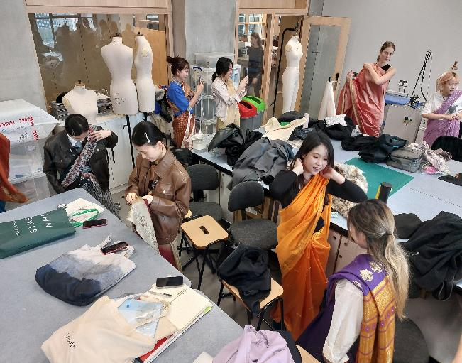
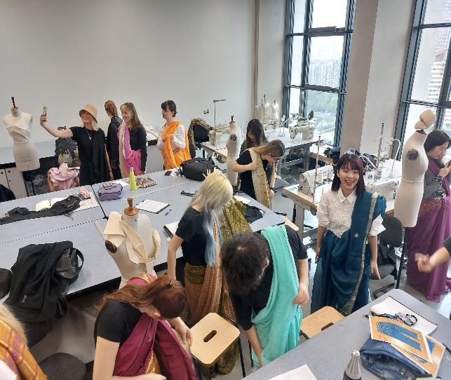

Slide 13
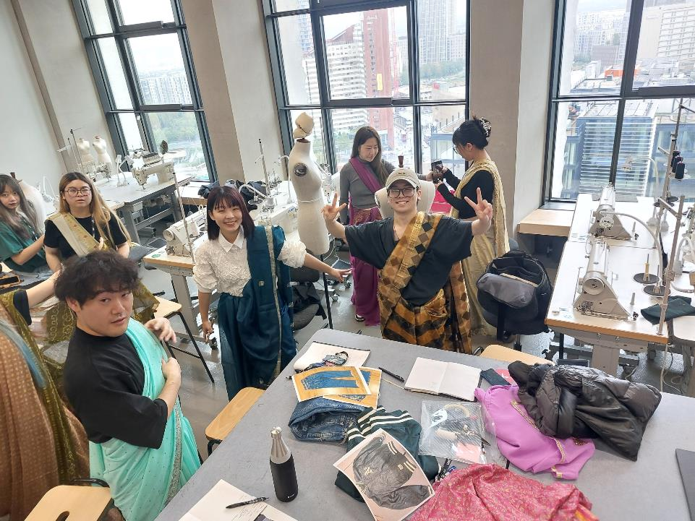

Slide 14
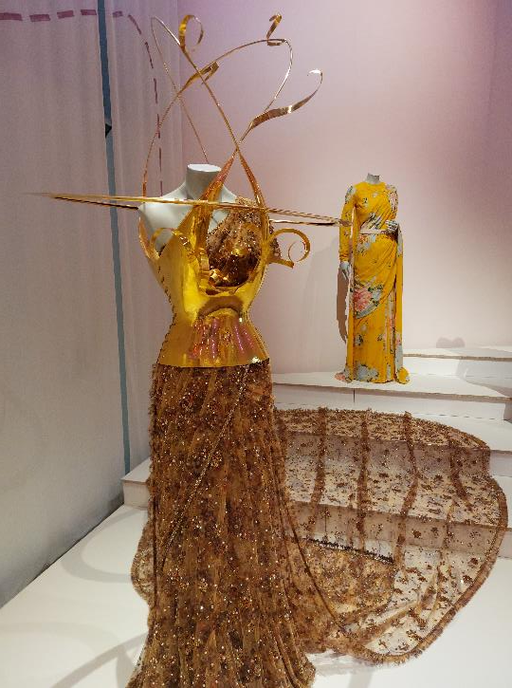
TASK 2
90 minutes
Drape to create shape
Drape over objects or constructions on the mannequin which then can be removed
For drapes, using folding and pleating methods

Slide 15
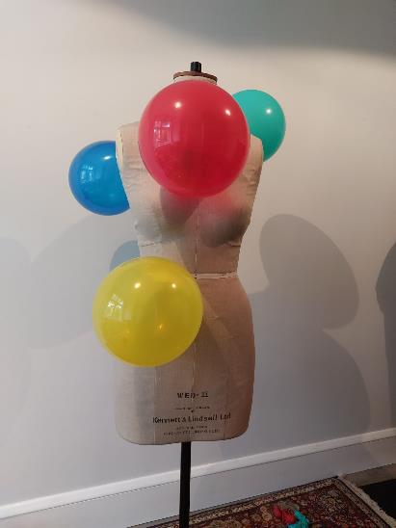
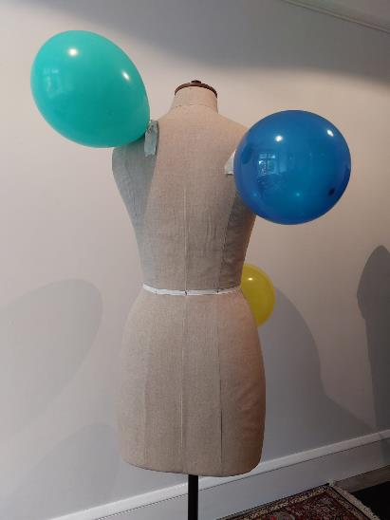
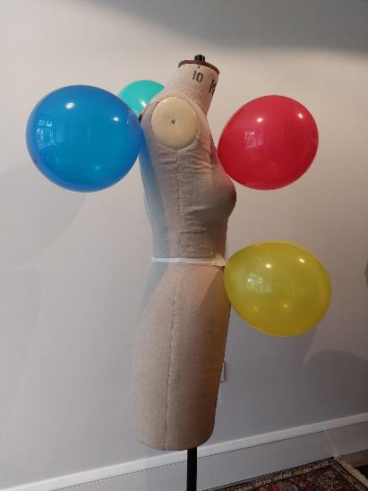

Slide 16
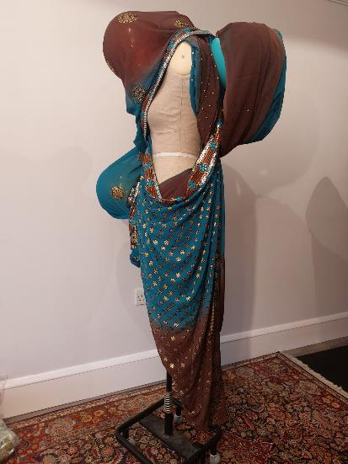
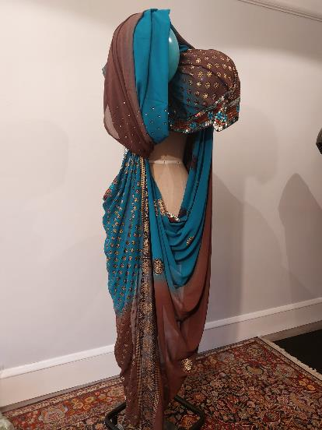
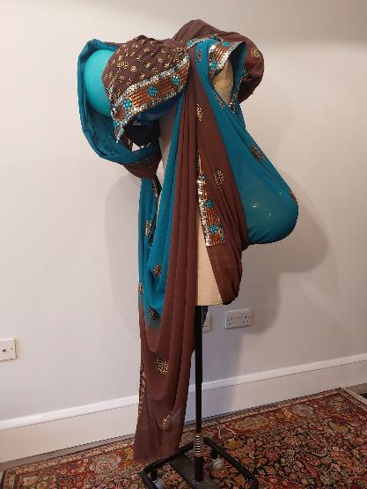

Slide 17
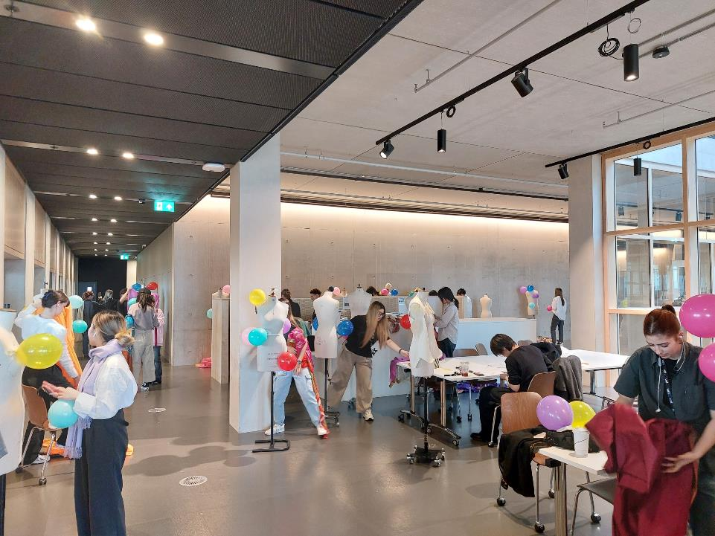

Slide 18
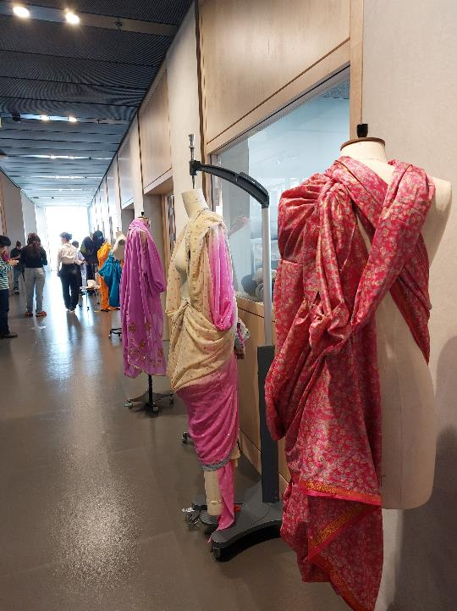
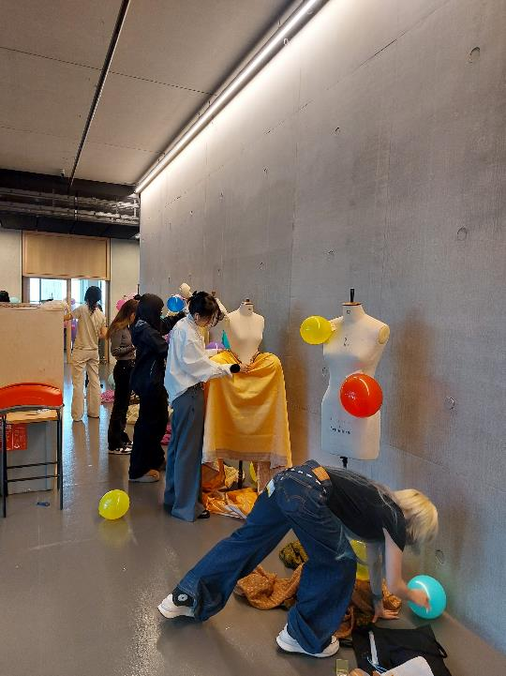

Slide 19
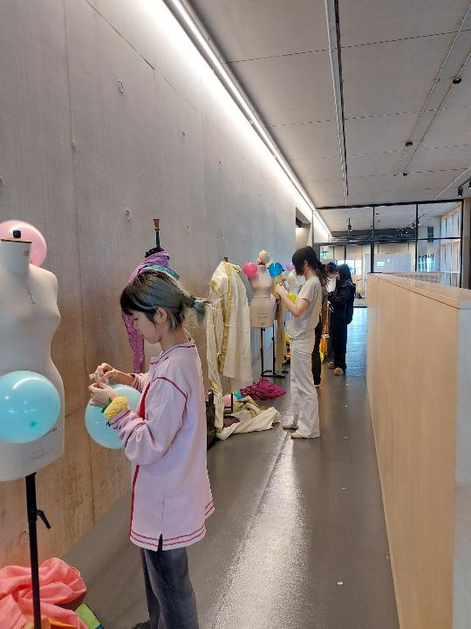
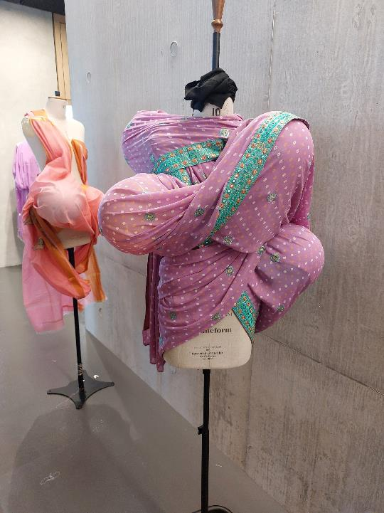

Slide 20

TASK 3
120 minutes
Create a new garment through
CROSS-POLLINATION
Use your sari drape,
then take a with zero waste pattern,
cross-pollinate with historical or modern garment to create a whole new garment
You are allowed to slash fabric or
cut out triangles, circles or squares
but must reuse all the pieces to create zero-waste

Slide 21
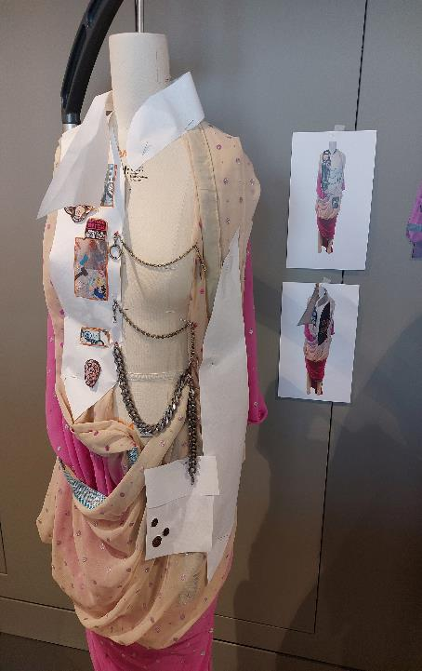
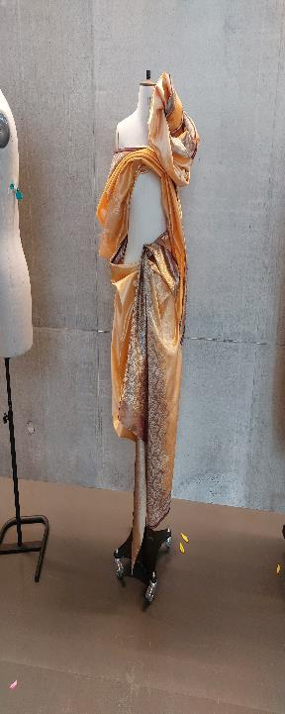
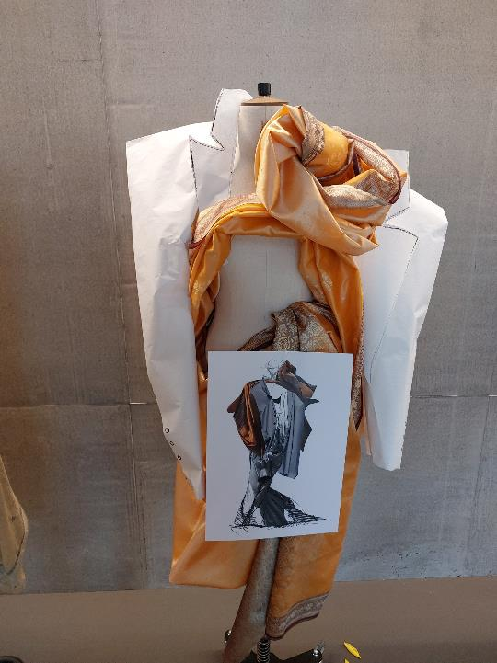

Slide 22
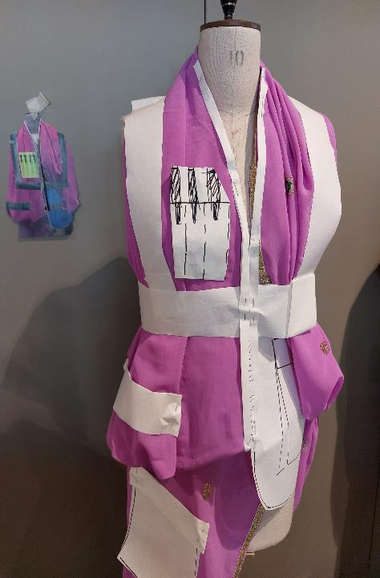
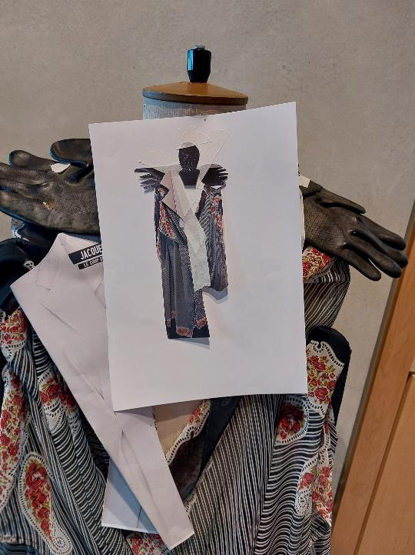
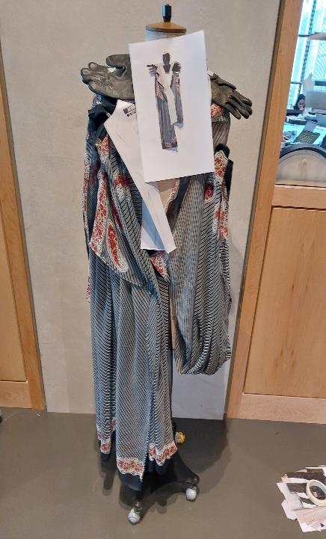

Slide 23


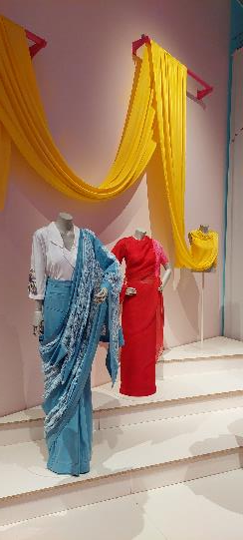
Crossing time

Slide 24
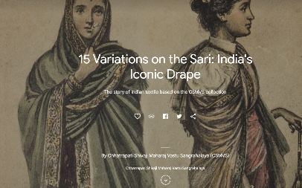
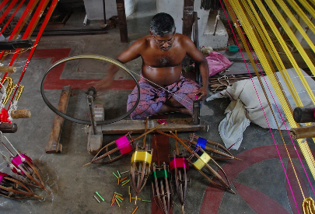
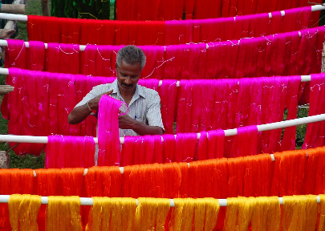
Sources and credits
- 15 Variations on the Sari: India's Iconic Drape — Google Arts & Culture
- The story of the sari in India and beyond (nationalgeographic.com)
- How Gen Z is putting a fresh spin on a centuries-old fashion - BBC Culture - How-to Drape Films - The Sari Series
- https://rmit.pressbooks.pub
- https://www.kalkifashion.com/
- Navratna Gemstones: The 9 Celestial Stones – Precious Earth
- What are aniline dyes? - The Dreamstress
- Traditional silk saree weavers of Kancheepuram- The New Indian Express
- Krishna saris.com
- mirraw.com
- bbc.co.uk
- gfa.org

